Slide 1
ECE4713
A R C H I T E C T U R E D A W G S
Siddhant Sutar, Veera Karri, Mabry Wilkinson

Slide 2
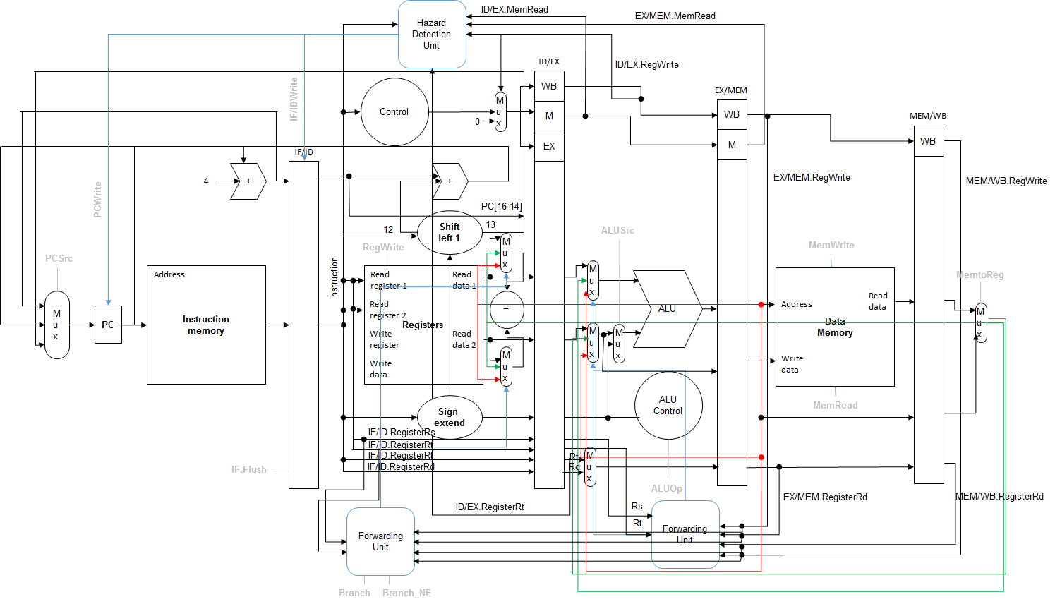
DATAPATH
16-bits RISC processor
Features: Pipelined datapath, Control Unit, ALU Control, ALU, EXE Forwarding Unit, Hazard Detection Unit, ID Forwarding Unit, Branch and Jump Hardware in ID

Slide 3
INSTRUCTIONSET
Name | Mnemonic | Opcode | Func | Format
Add | add | 0000 | 100 | R
Add Immediate | addi | 0001 | - | I
Bitwise AND | and | 0000 | 101 | R
Bitwise AND Immediate | andi | 0010 | - | I
Branch if Equal | beq | 0011 | - | I
Branch if Not Equal | bne | 0100 | - | I
Jump to Address | j | 0101 | - | J
Load Word | lw | 0111 | - | I
Bitwise XOR | xor | 0000 | 000 | R
Bitwise OR | or | 0000 | 110 | R
Bitwise OR Immediate | ori | 1000 | - | I
Set to 1 if Less Than | slt | 0000 | 111 | R
Set to 1 if Less Than Immediate | slti | 1001 | - | I
Logical Shift Left | sll | 0000 | 001 | R
Logical Shift Right | srl | 0000 | 010 | R
Subtract | sub | 0000 | 011 | R
Store Word | sw | 1010 | - | I

Slide 4
CONTROLUNIT
Stage: ID
Input: 4-bit instruction opcode, Instruction(16-13)
Output: control signals RegDst, ALUSrc, ALUOp2, ALUOp1, ALUOp0, Jump, Branch, Branch_NE, MemRead, MemWrite, MemToReg, RegWrite
Description: depending upon the opcode, set the appropriate control signals based on instruction type

Slide 5
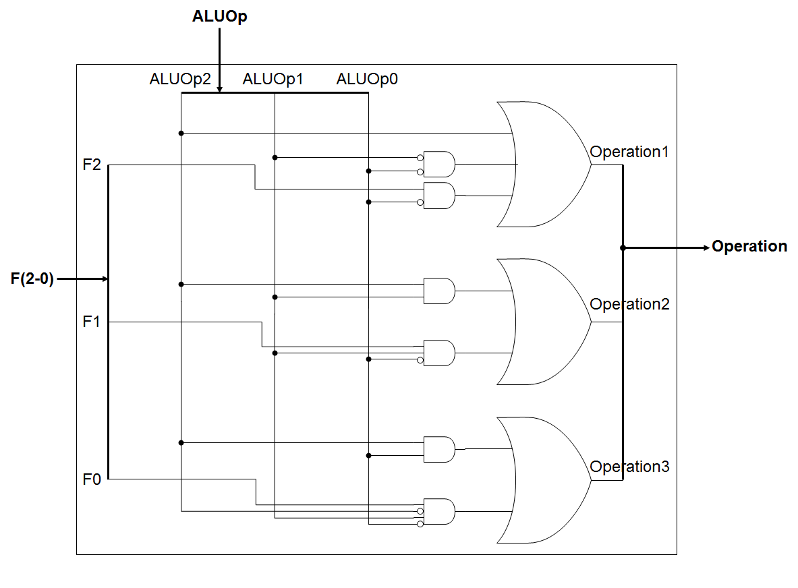
ALUCONTROL
Stage: EXE
Input: Funct code, F(2-0) and ALUOp code, ALUOp(2-0)
Output: Operation code, Operation(2-0)
Description: depending upon the instruction, generate the appropriate operation code for the ALU

Slide 6
ARITHMETICLOGICUNIT
Stage: EXE
Input: Read data 1, Read data 2 (initialized), or forwarded values
Output: ALU Result
Description: performs an arithmetic operation based on the Operation code provided by ALU Control

Slide 7
BRANCHHARDWARE
Stage: ID
Purpose: Handle control hazards
Description: Branch and jump adders are moved from EXE stage to ID stage to reduce unnecessary stall cycles and branch penalties during control hazards; equality comparator added to detect the outcome of the branch in ID stage itself

Slide 8
EXEFORWARDINGUNIT
Stage: EXE
Purpose: Handle regular (non-load-use) data hazards
Input: EX/MEM.RegWrite, MEM/WB.RegWrite, EX/MEM.RegisterRd, MEM/WB.RegisterRd, ID/EX.RegisterRs, ID/EX.RegisterRt
Output: Forwarded paths 01 (MemtoReg mux output), 10 (ALU Result)
Description: Forwarding required when RegWrite and Rd equals Rs/Rt
ID forwarding unit works similarly for handling non-load-use-data hazards on branches

Slide 9
HAZARDDETECTIONUNIT
Stage: ID
Purpose: Handle load-use data hazards, load-use data hazards on branches
Input: Branch, Branch_NE, ID/EX.MemRead, ID/EX.RegWrite, EX/MEM.MemRead, ID/EX.RegisterRt, ID/EX.RegisterRd, IF/ID.RegisterRs, IF/ID.RegisterRt
Output: 0 if hazard detected, 1 otherwise
Description: Hazard detected when: MemWrite and ID/EX.RegisterRt equals Rs/Rt or Branch/Branch_NE and MemRead/RegWrite and Rd equals Rs/Rt

